Slide 1

AI in Business Tools, Technology & Demos Presented By Brian Byrne MSc.

Slide 2
LAB SETUP
NOTE: YOU MUST HAVE A GOOGLE ACCOUNT TO RUN THE LAB
OPEN A BROWSER AND GO TO : https://colab.research.google.com
LAB 1:
https://github.com/bhrionn/CORVINUS-AI/blob/main/CaliforniaHousingDataNotebook.ipynb
LAB 2
https://github.com/bhrionn/CORVINUS-AI/blob/main/plot_digits_classification.ipynb

Slide 3
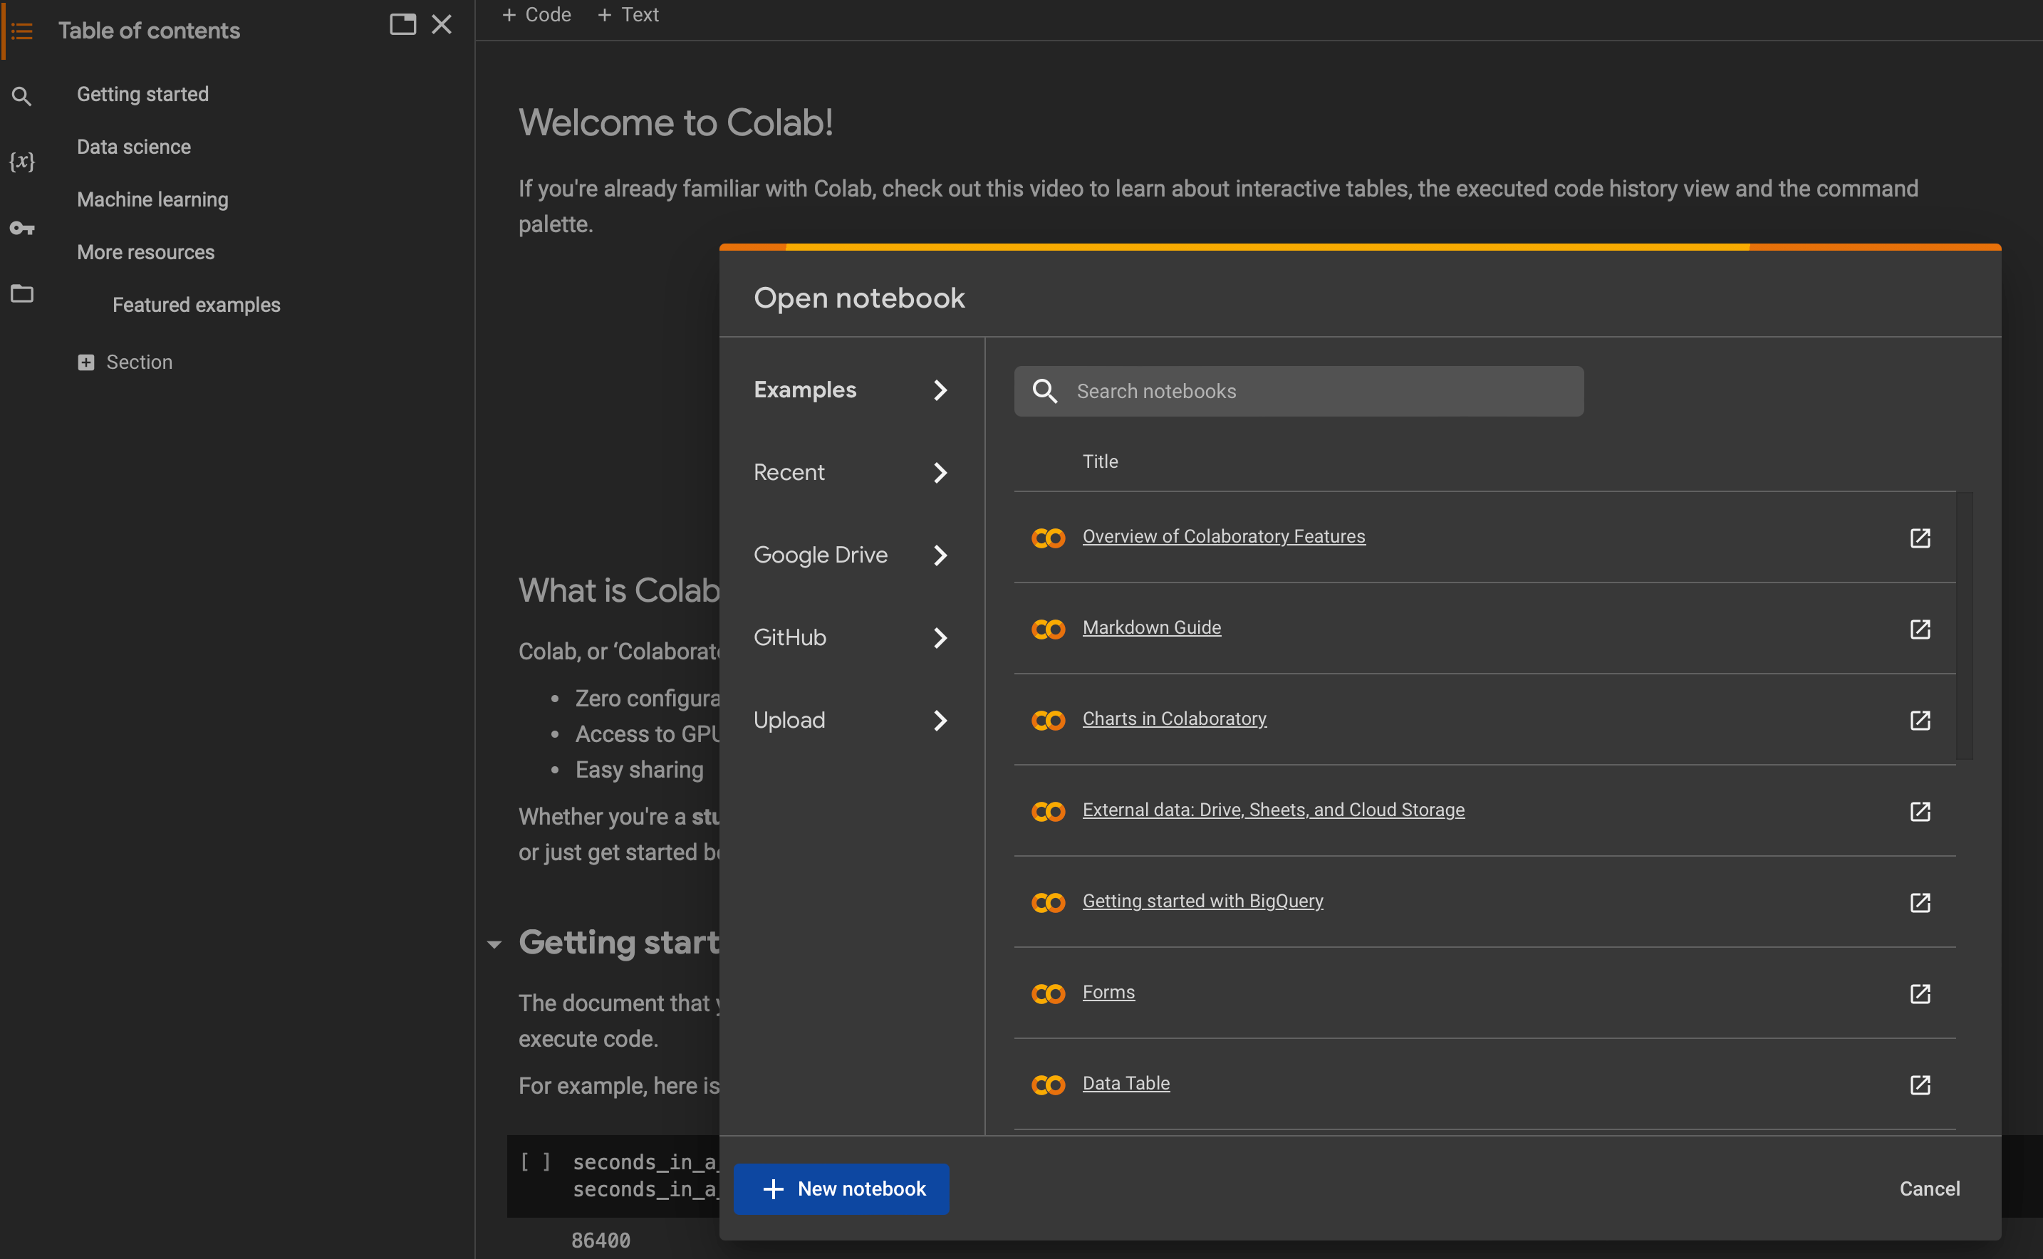
Welcome to Colab Screen

Slide 4
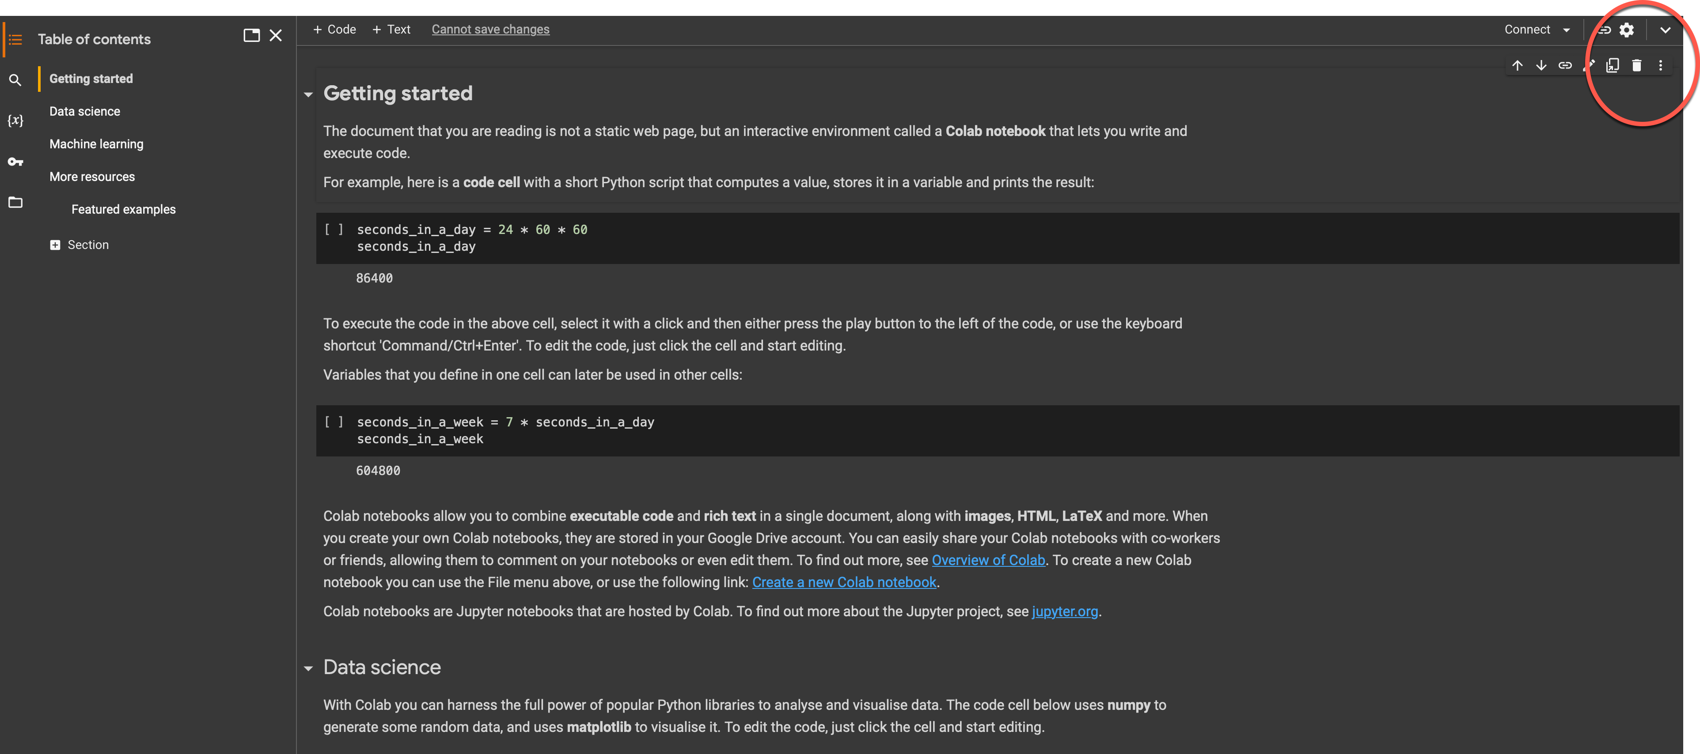
EXPAND DROPDOWN

Slide 5
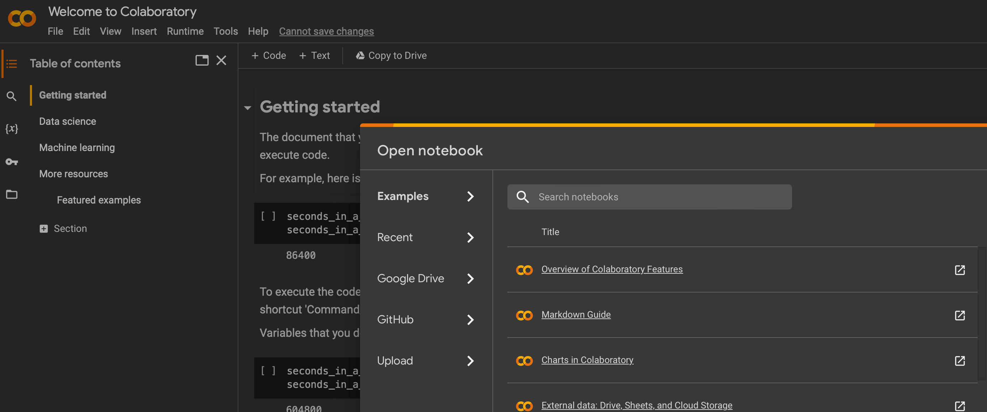
FILE > OPEN > GITHUB >
Got to top left hand side
Choose FILE – Open notebook – Go to GitHub Section

Slide 6
FIND LAB FILE AND OPEN THE FILE
Type ‘bhrionn’ to see bhrionn/CORVINUS-AI
Select File ‘CaliforniaHousingDataNotebook’
… open the lab file pasting the following URL in :
OR PASTE IN THE URL:
https://github.com/bhrionn/CORVINUS-AI/blob/main/CaliforniaHousingDataNotebook.ipynb

Slide 7
LOGIN TO COLAB WITH GOOGLE AC
Login to COLAB in order to run each cell in the demo

Slide 8
California Housing Prices dataset
Widely used benchmark dataset in machine learning for regression tasks
Contains information on housing prices in the Californian suburbs of San Francisco and San Jose between 1979 and 1991.
Dataset comprises 207 entries, each representing a single house, and includes 8 attributes.
Objective of using this dataset is to predict the median house value based on the given attributes.
Valuable tool for evaluating the performance of various machine learning algorithms, particularly linear regression
Median Income: The median income in the census tract where the house is located.
House Size: The total area of the house in square feet.
Number of Bedrooms: The number of bedrooms in the house.
Number of Bathrooms: The number of bathrooms in the house.
Year Built: The year the house was built.
Population: The population of the census tract where the house is located.
Latitude: The latitude of the house's location.
Longitude: The longitude of the house's location.

Slide 9
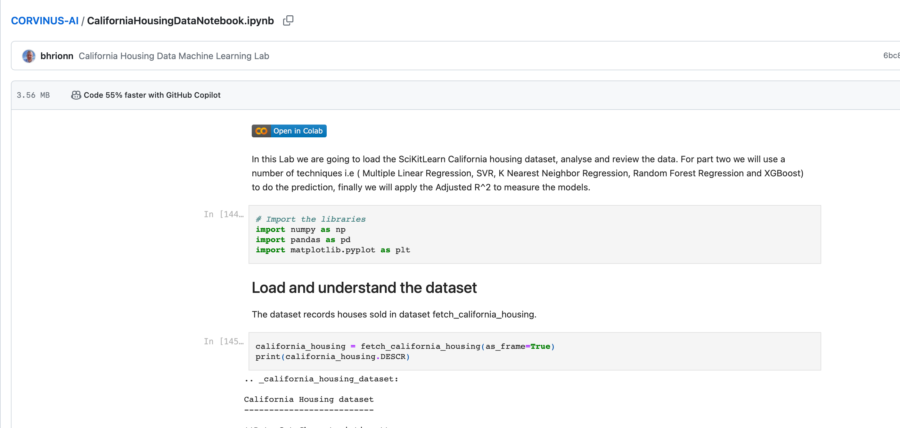
In COLAB - Open file location
FILE LOCATION
https://github.com/bhrionn/CORVINUS-AI/blob/main/CaliforniaHousingDataNotebook.ipynb
COLAB LOCATION
https://colab.research.google.com/github/bhrionn/CORVINUS-AI/blob/main/CaliforniaHousingDataNotebook.ipynb#scrollTo=T4A3bsIKeFO3

Slide 10
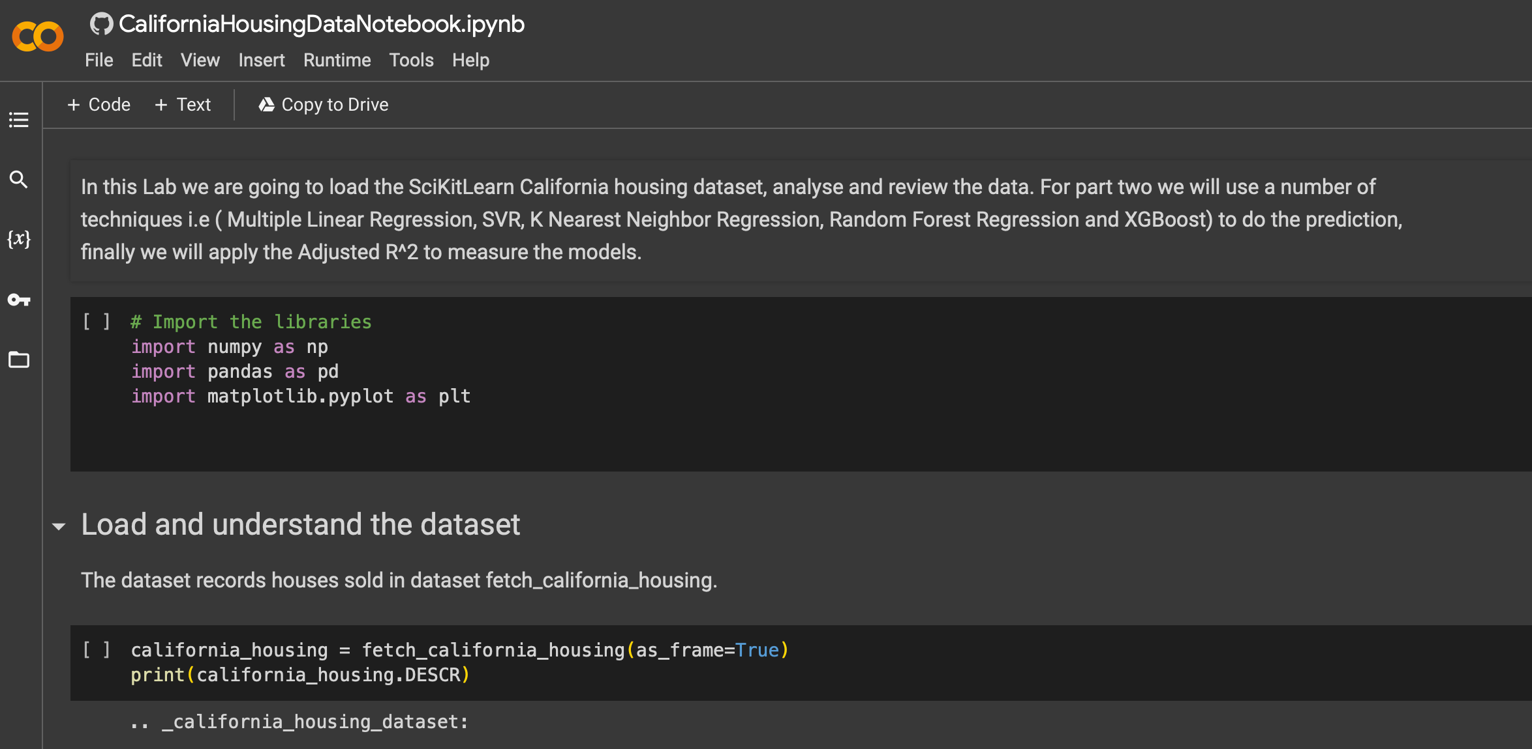
Open COLAB

Slide 11
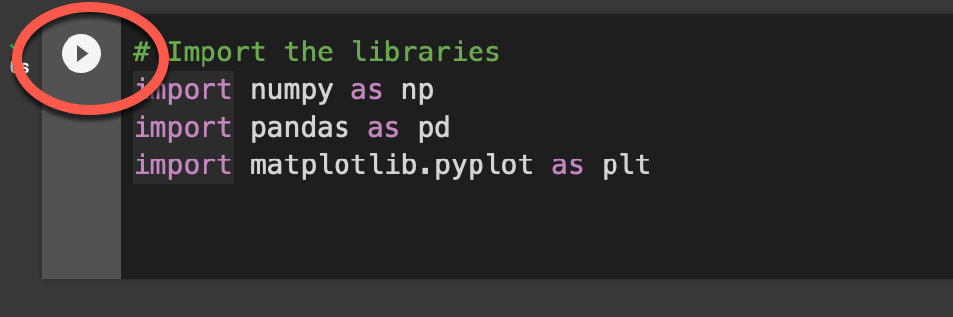
RUN EACH CELL
Click into a cell
Press ‘SHIFT + ENTER’ .. TO RUN THE CELL … OR
Press the play button!
… wait until a number appears
.. Repeat for each code section

Slide 12
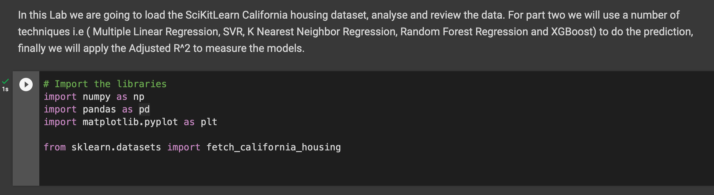
1. Import some libraries

Slide 13
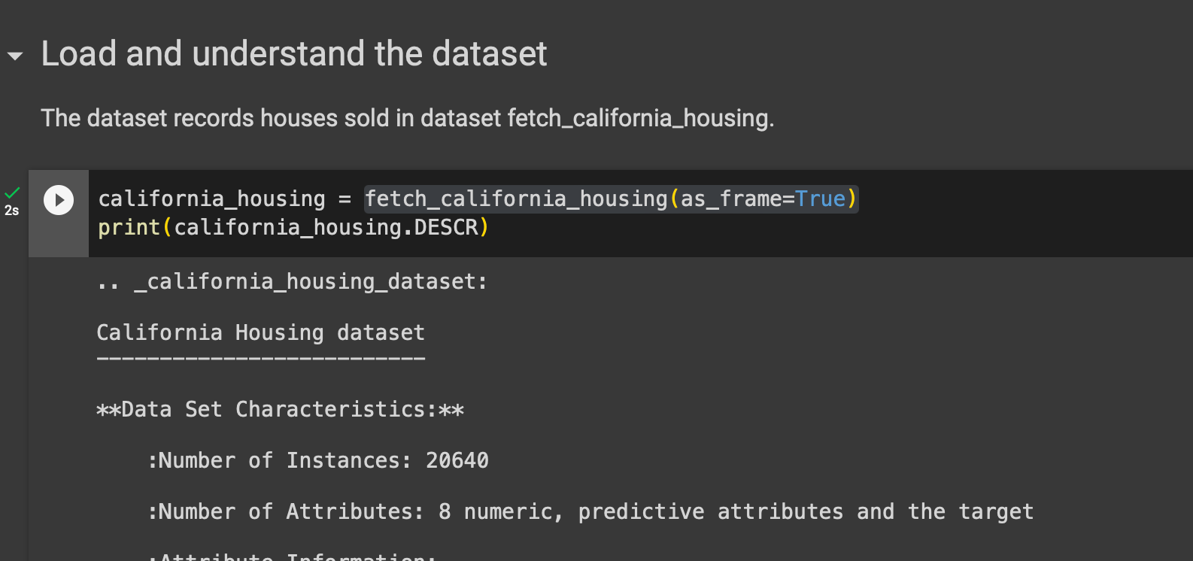
2. Load and Understand Data

Slide 14
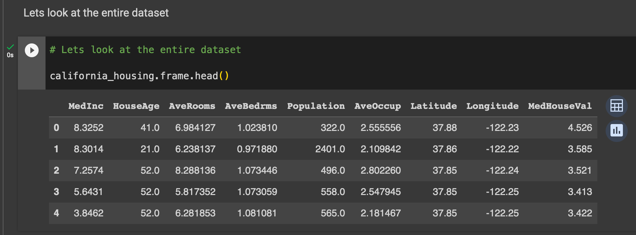
3. Look at entire DataSet

Slide 15
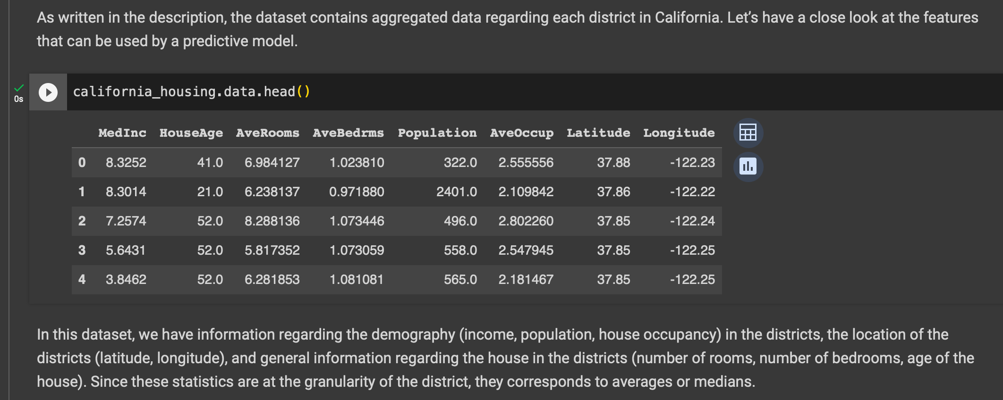
4. Look at features used by predictive Model

Slide 16
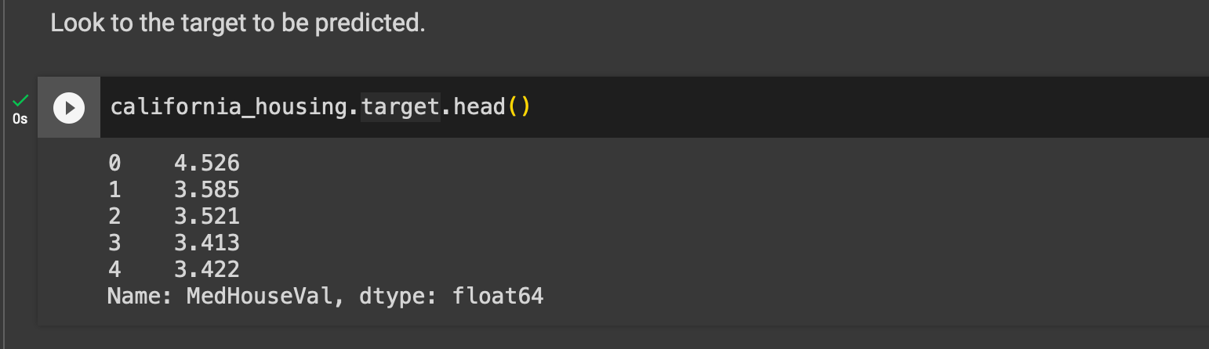
5. Look at the target to be predicted

Slide 17
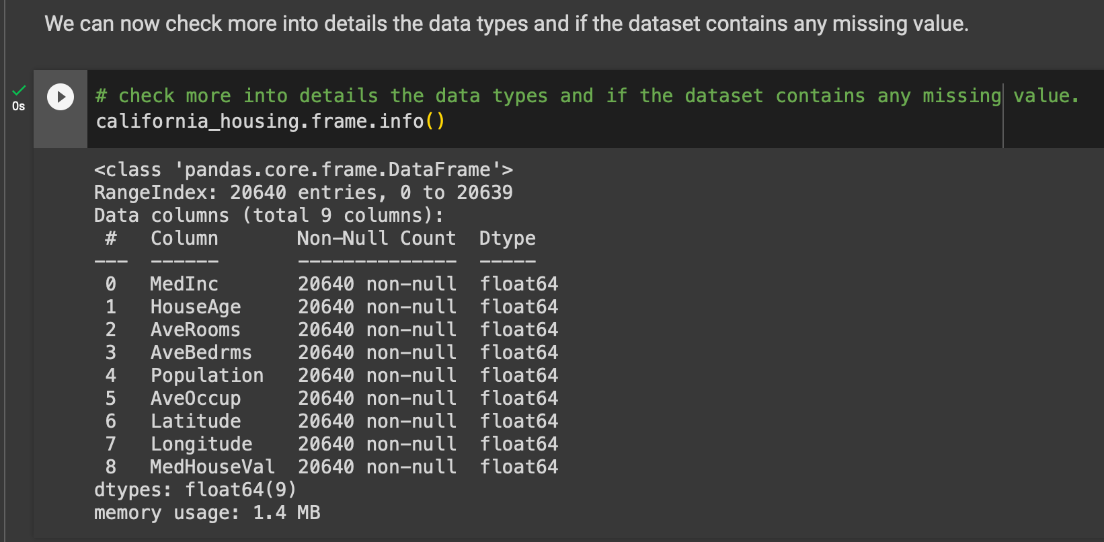
6. Check if any missing values present
We can see that:
the dataset contains 20,640 samples and 8 features;
all features are numerical features encoded as floating number;
there is no missing values.

Slide 18
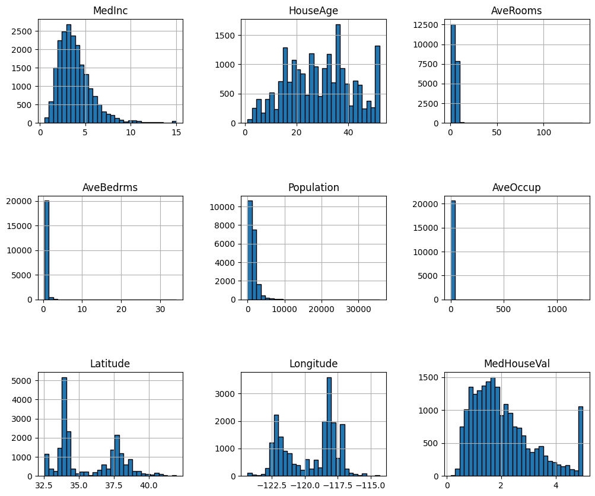
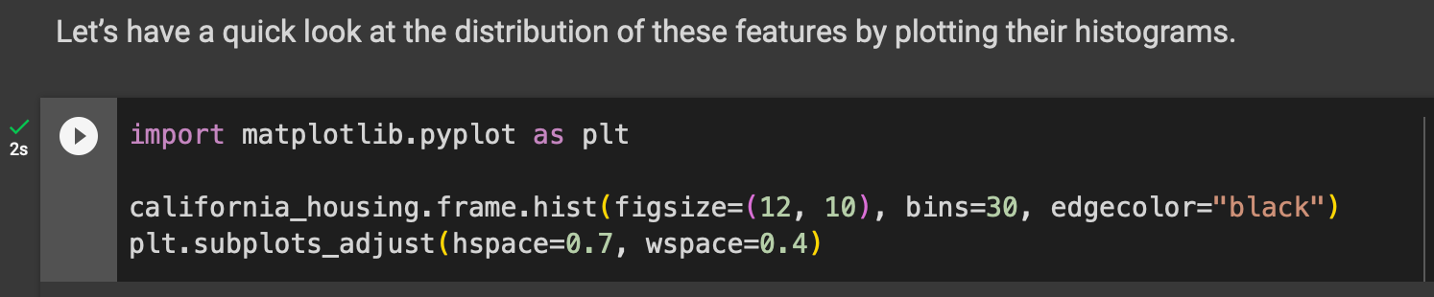
7. Look at distribution of features
We can first focus on features for which their distributions would be more or less expected.
The median income is a distribution with a long tail. It means that the salary of people is more or less normally distributed but there is some people getting a high salary.Regarding the average house age, the distribution is more or less uniform.
The target distribution has a long tail as well.

Slide 19
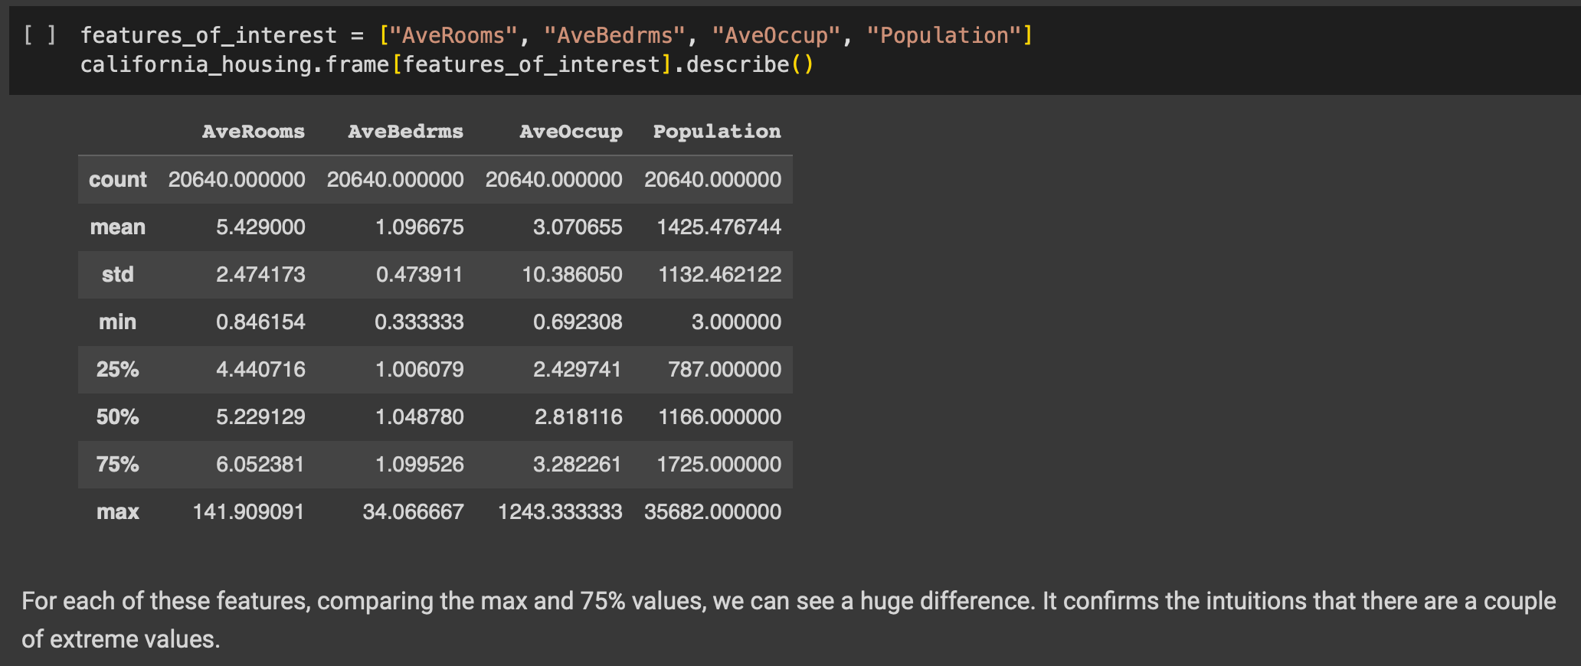
Statistical Features of Interest

Slide 20
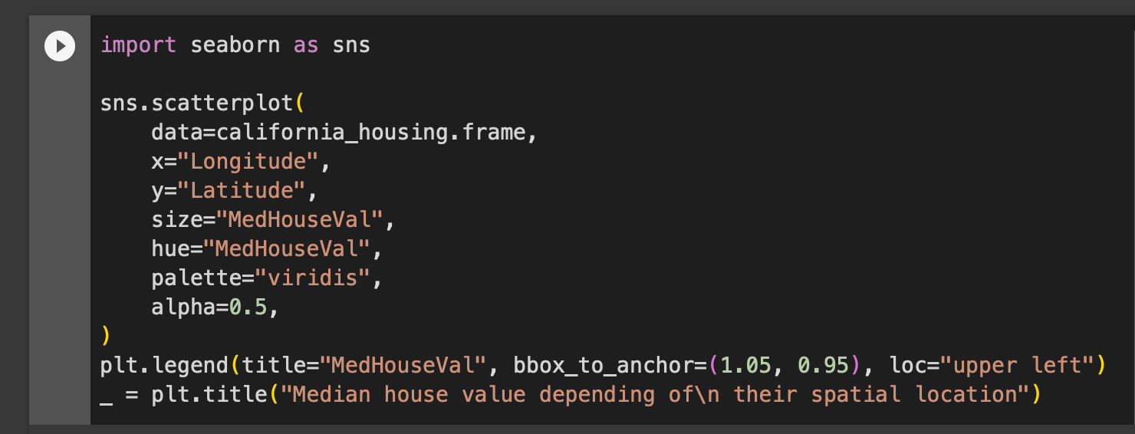
ScatterPlot of latitude, longtitude

Slide 21
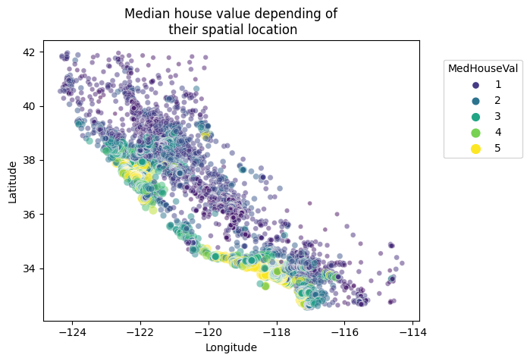
ScatterPlot of latitude, longtitude

Slide 22
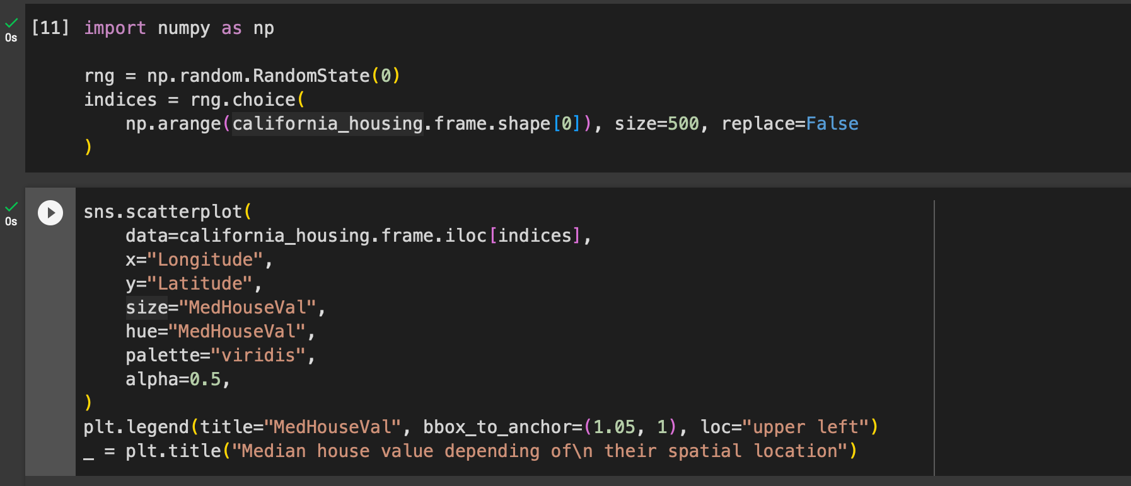
Random subsampling to have less data to plot but still see specifics

Slide 23
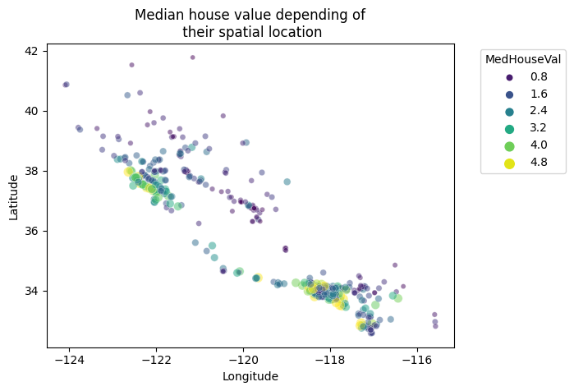
Random subsampling to have less data to plot but still see specifics

Slide 24
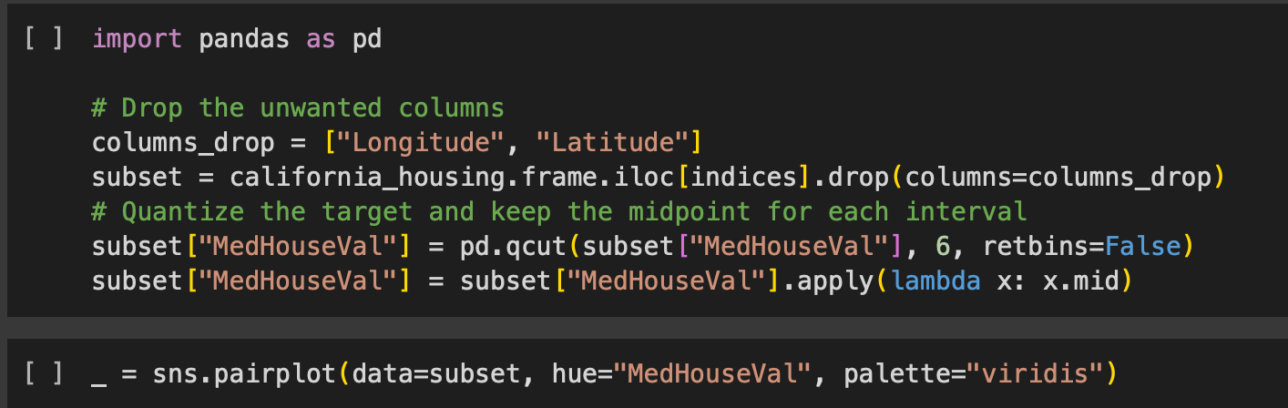
Pairplot of all features and the target

Slide 25
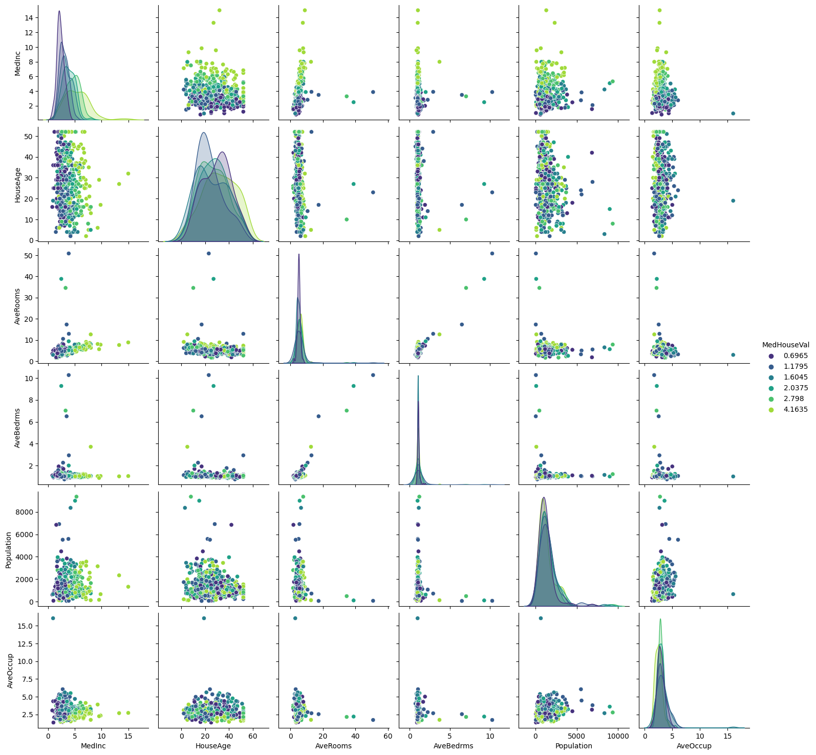
Pairplot of all features and the target

Slide 26
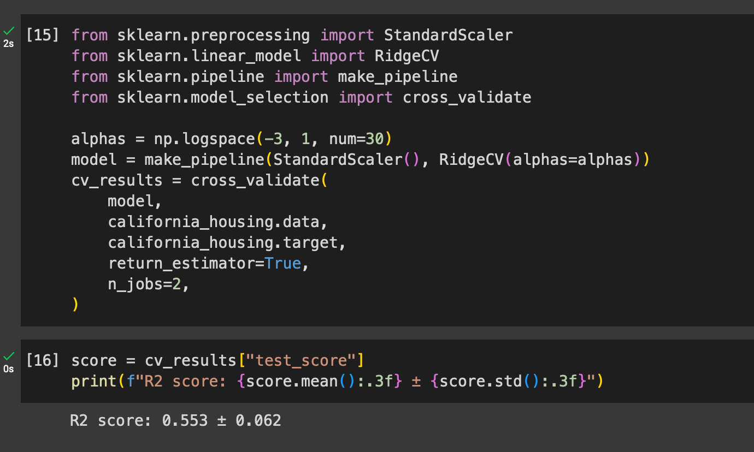
Create linear Predictive Model

Slide 27
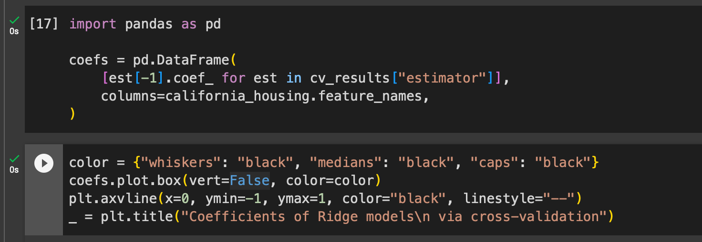
Coefficients of Ridge Model via Cross-validation

Slide 28
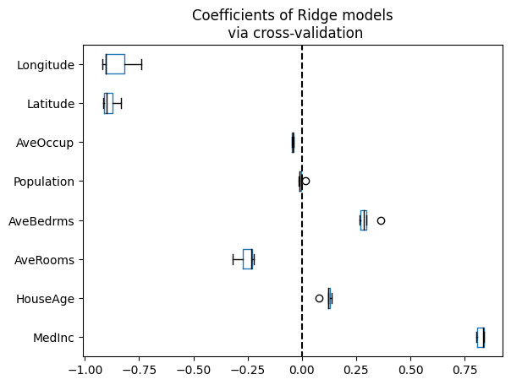
Coefficients of Ridge Model

Slide 29
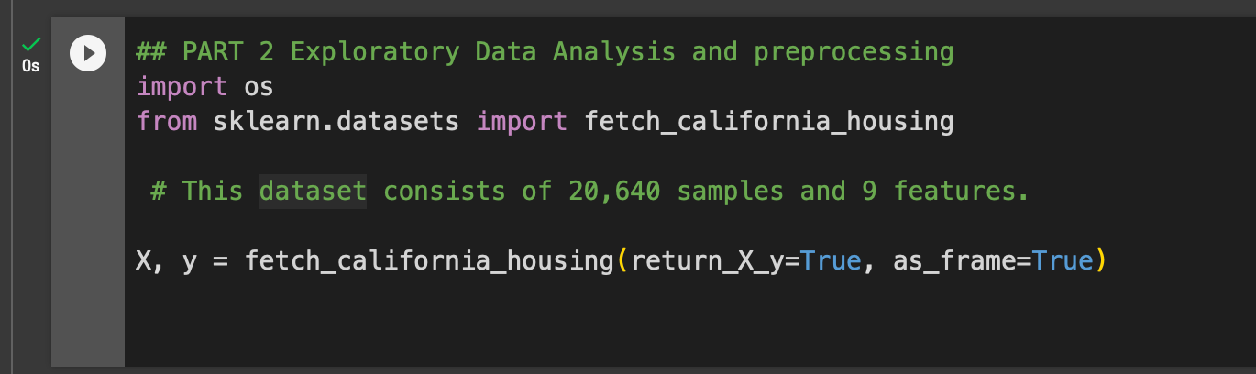
Exploratory Data Analysis

Slide 30
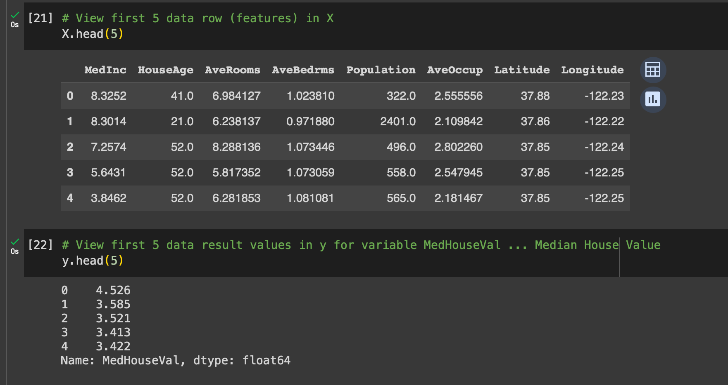
Split Data intro X and Y

Slide 31
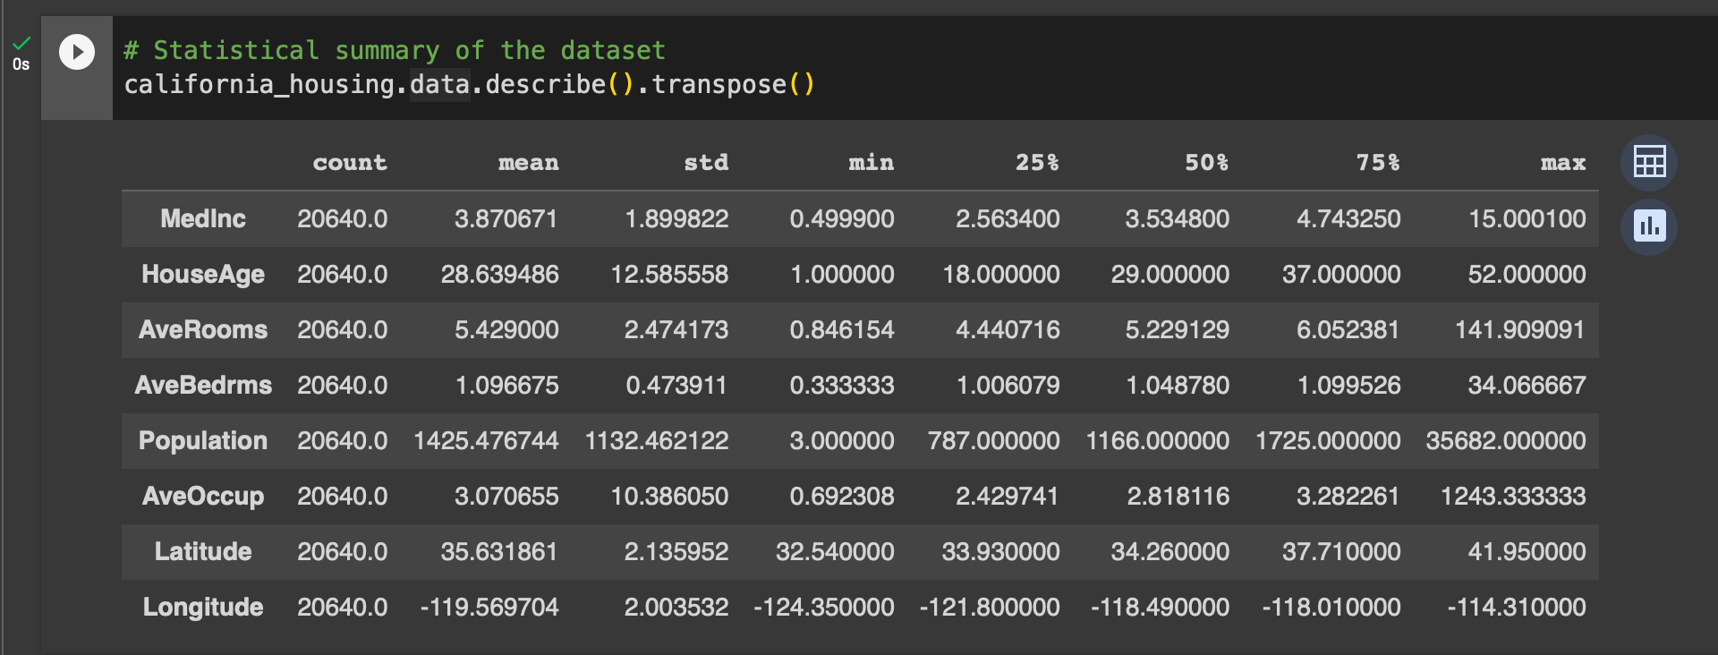
Transpose data and review

Slide 32
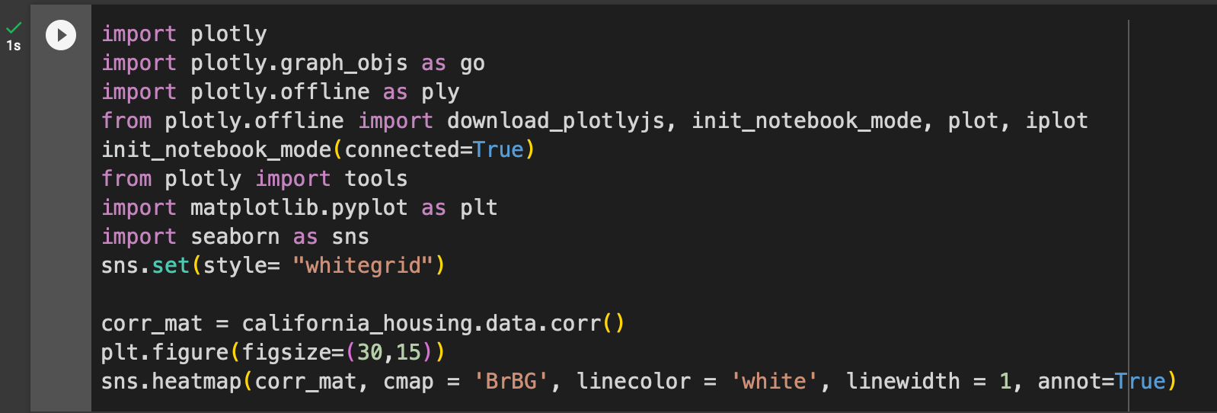
Heat Map to show correlation amoung the variables

Slide 33
What is a heatmap ?
A heatmap is a graphical representation of data where the individual values within a dataset are represented as colors. The color scheme typically uses a gradient from cool to hot, with darker colors representing lower values and brighter colors representing higher values. Heatmaps are a useful tool for visualizing large amounts of data and identifying patterns.
In the context of the California Housing Prices dataset, a heatmap could be used to visualize the relationship between different attributes and the median house value. For example, a heatmap could be created to show how the median house value varies by median income, house size, number of bedrooms, number of bathrooms, year built, population, latitude, and longitude. This heatmap could help to identify which attributes have the strongest correlation with the median house value.

Slide 34
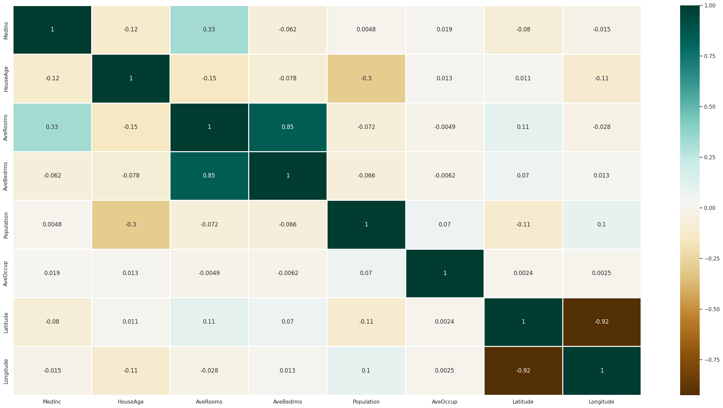
Heat Map to show correlation amoung the variables

Slide 35
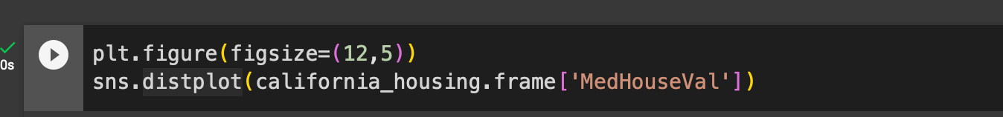
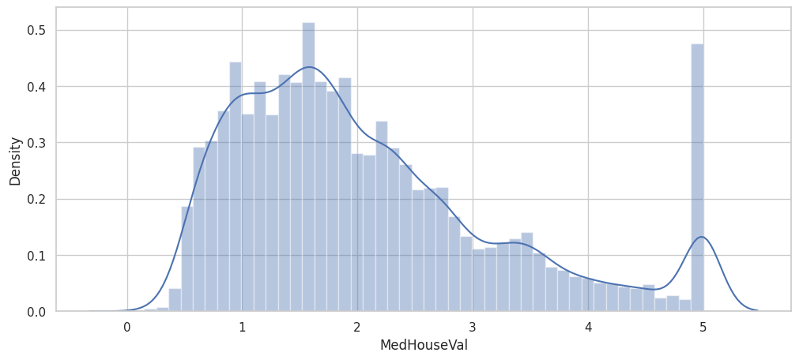
Distribution plot of price

Slide 36
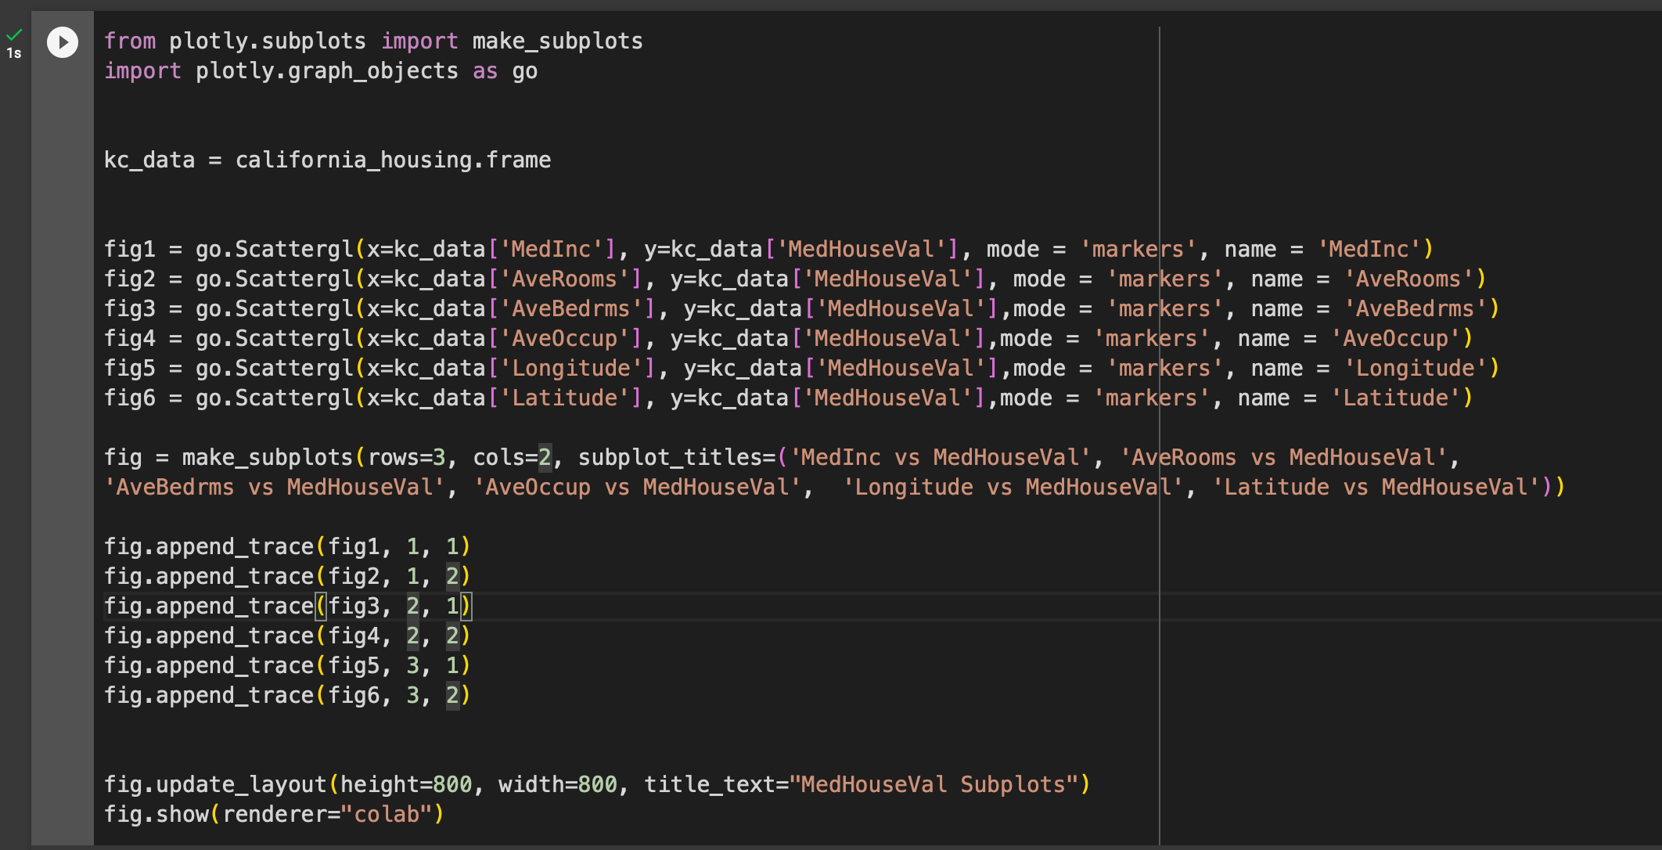
Scatter subplots for further data analysis

Slide 37
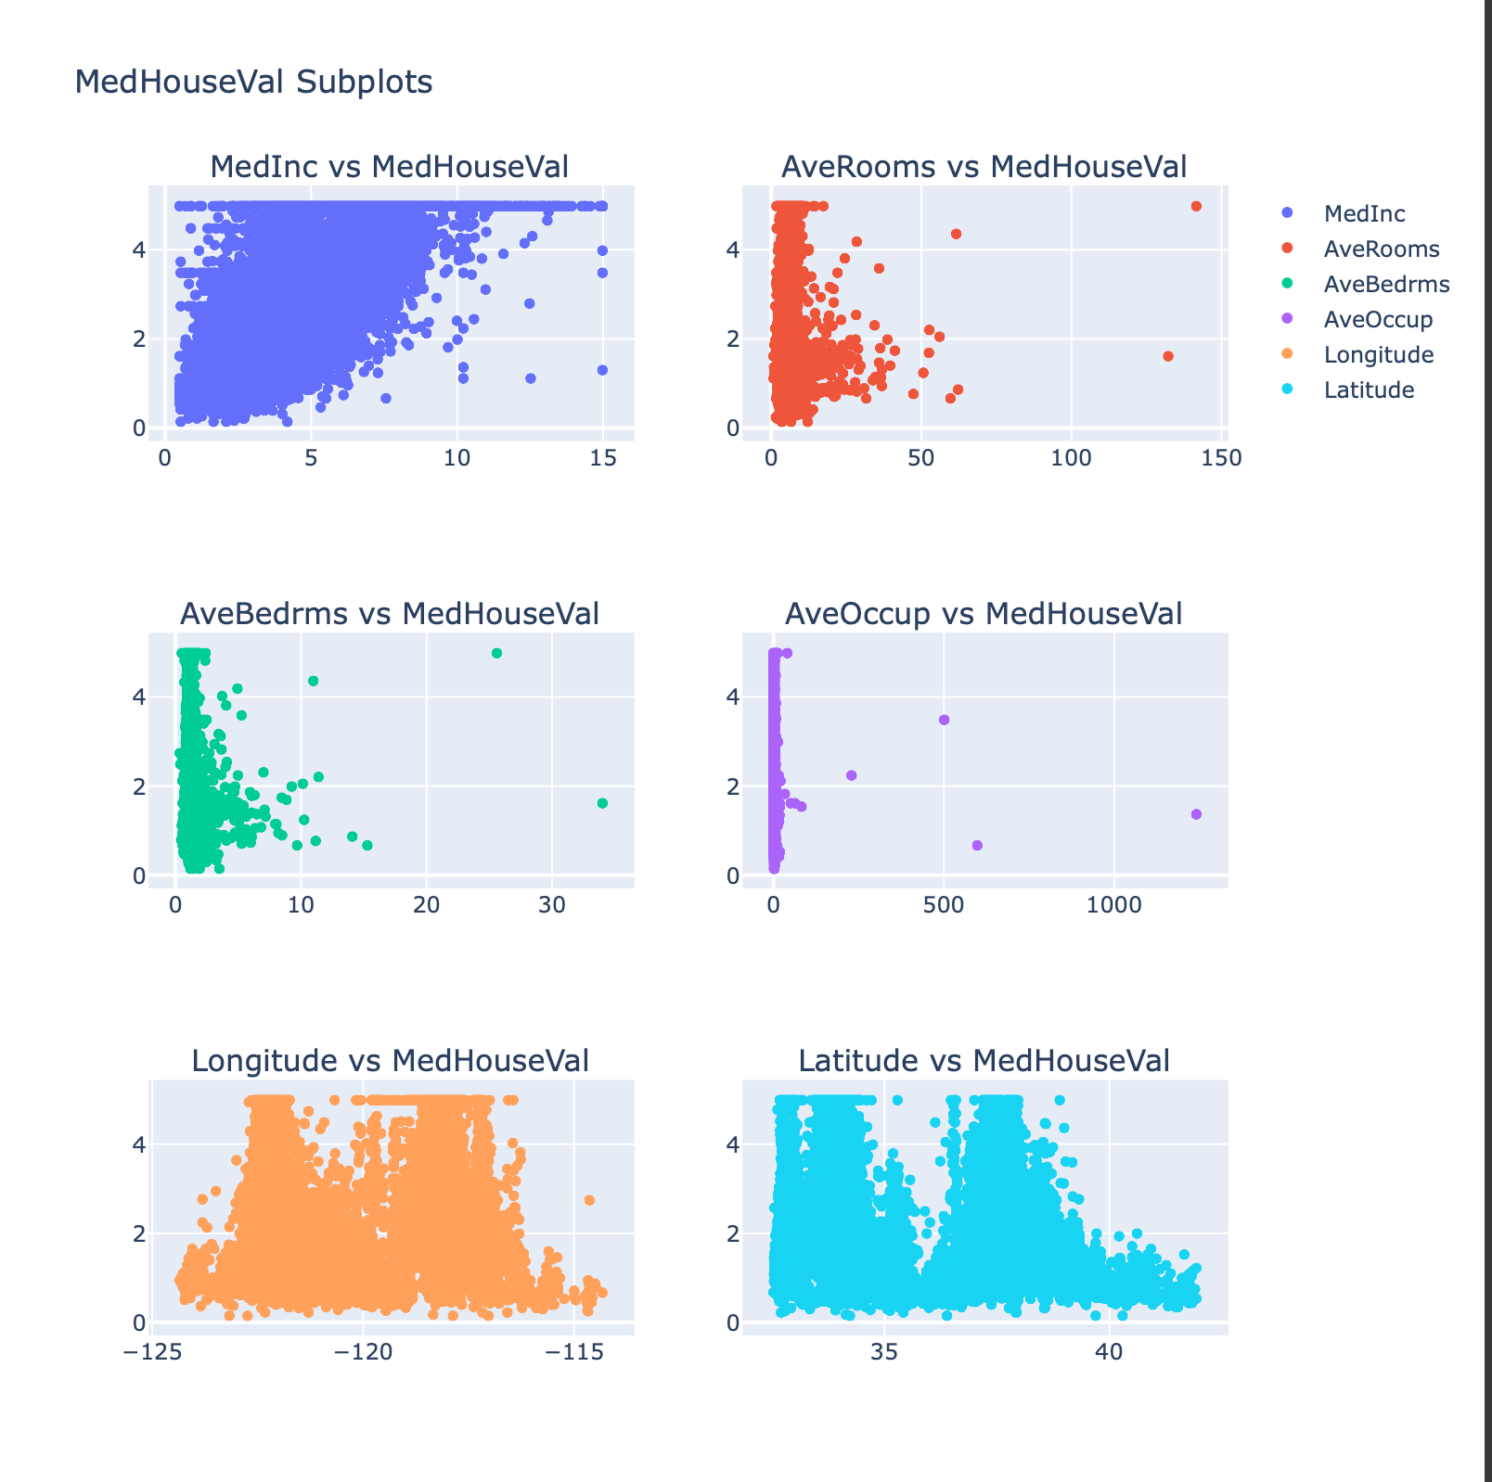
Scatter subplots for further data analysis

Slide 38
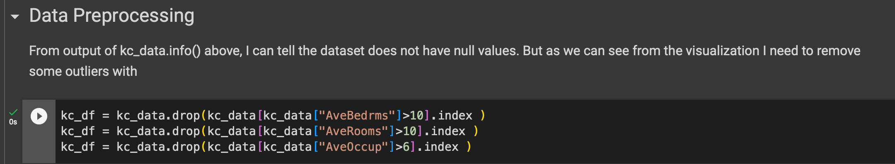
Data Preprocessing to remove outliers

Slide 39
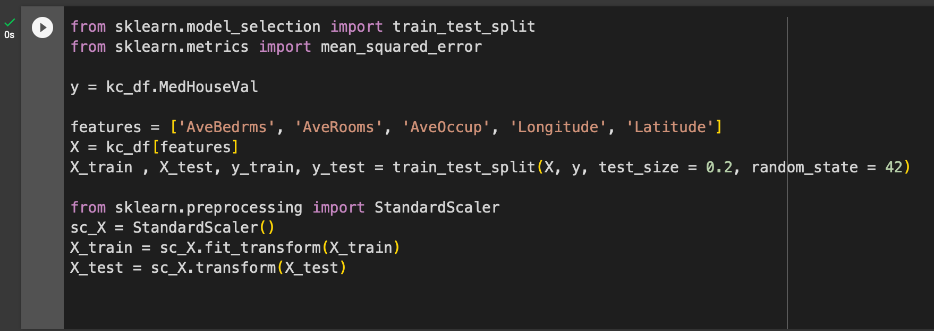
Create X, y split data for training and testing

Slide 40
What is train test split ?
Train-test split is a technique used in machine learning to evaluate the performance of a model. It involves dividing the dataset into two subsets: the training set and the testing set. The training set is used to train the model, while the testing set is used to evaluate its performance on unseen data.
The purpose of train-test split is to avoid overfitting. Overfitting occurs when a model learns the training data too well and is unable to generalize to new data. By evaluating the model on a separate testing set, we can assess its ability to generalize and make accurate predictions on unseen data.
The typical ratio of training data to testing data is 70:30. This means that 70% of the data is used for training and 30% is used for testing. However, the exact ratio can be adjusted depending on the size and nature of the dataset.

Slide 41
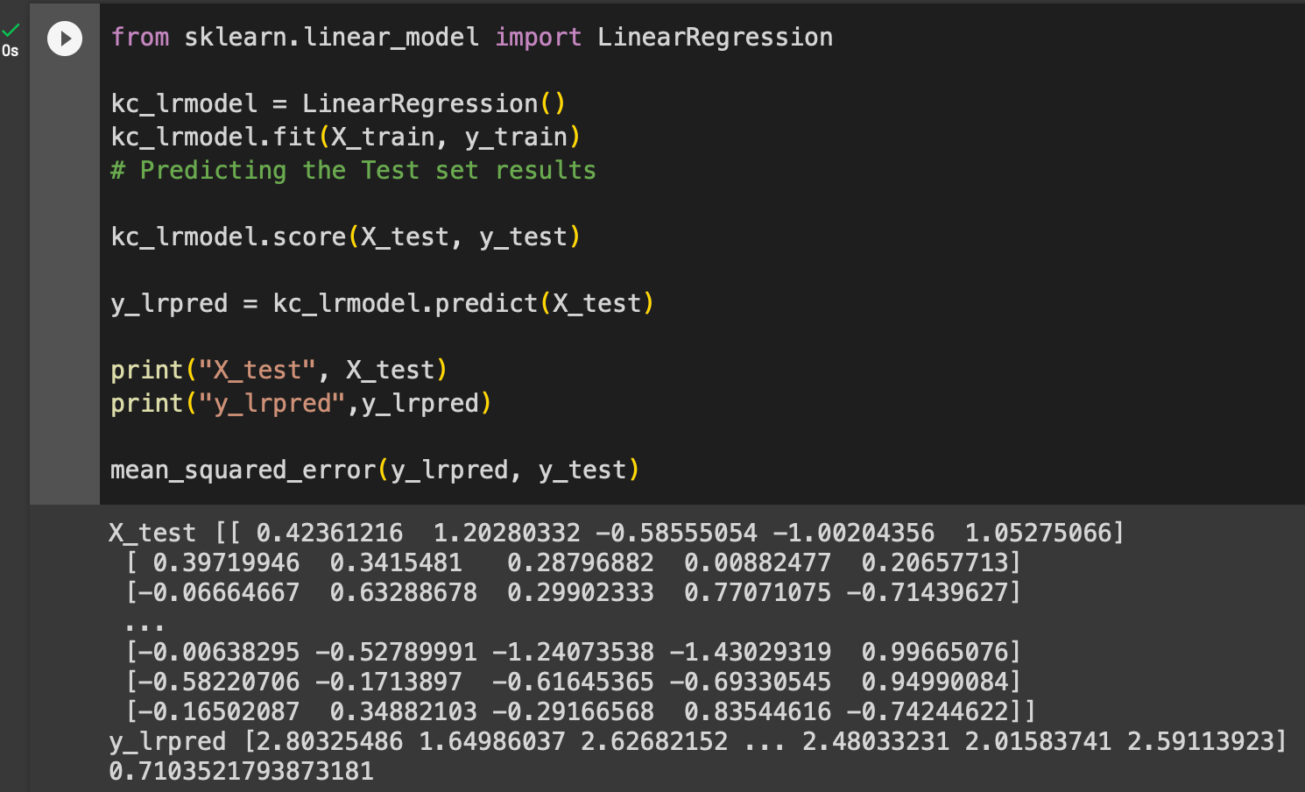
Create Linear Regression Model

Slide 42
What is a linear regression model ?
Linear regression is a statistical method used to model the relationship between one or more independent variables and a dependent variable. It assumes that the relationship between the variables is linear, meaning that a change in one independent variable will result in a proportional change in the dependent variable.
Linear regression is a simple and versatile method that can be used to model a wide variety of data. It is one of the most commonly used statistical methods in machine learning.
The formula for linear regression is:
y = mx + b
where:
y is the dependent variable
x is the independent variable
m is the slope of the line
b is the y-intercept of the line
The slope of the line represents the change in the dependent variable for every one unit change in the independent variable. The y-intercept represents the value of the dependent variable when the independent variable is zero.
To fit a linear regression model to a dataset, we use a technique called least squares. Least squares involves finding the values of m and b that minimize the sum of the squared errors between the predicted values of the dependent variable and the actual values of the dependent variable.

Slide 43
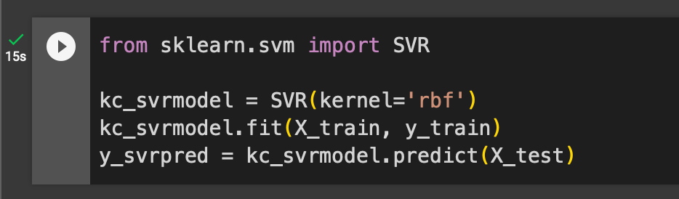
Create Support Vector Model

Slide 44
What is a Support Vector Regression Model
Support Vector Regression (SVR) is a powerful machine learning algorithm that can be used for regression tasks, particularly in scenarios where linear regression is not suitable. It is a supervised learning algorithm that aims to find a hyperplane that best fits the data points in a continuous space while minimizing the prediction error.
Key Characteristics of SVR:
Non-linear relationships: SVR can handle non-linear relationships between the input variables and the target variable, unlike linear regression, which is limited to linear relationships.
Robust to outliers: SVR is less sensitive to outliers compared to traditional regression algorithms, making it more robust to noisy data.
Kernel functions: SVR employs kernel functions to map the input data into a high-dimensional feature space, allowing it to capture complex non-linear relationships.
Margin maximization: SVR aims to maximize the margin between the hyperplane and the data points, ensuring that the most relevant support vectors define the hyperplane.
Regularization parameter: SVR incorporates a regularization parameter to control the complexity of the hyperplane, preventing overfitting and improving generalization.

Slide 45
Applications of Support Vector Regression
Applications of SVR:
Financial forecasting: SVR can be used to predict stock prices, exchange rates, and other financial indicators based on historical data and market trends.
Risk assessment: SVR can be used to assess the risk of various events, such as credit defaults, insurance claims, and natural disasters.
Sales forecasting: SVR can be used to predict future sales based on historical sales data, marketing campaigns, and economic conditions.
Medical diagnosis: SVR can be used to assist in medical diagnosis by predicting patient outcomes, identifying disease patterns, and personalized treatment plans.
Anomaly detection: SVR can be used to detect anomalies in various datasets, such as sensor readings, network traffic, and financial transactions.

Slide 46
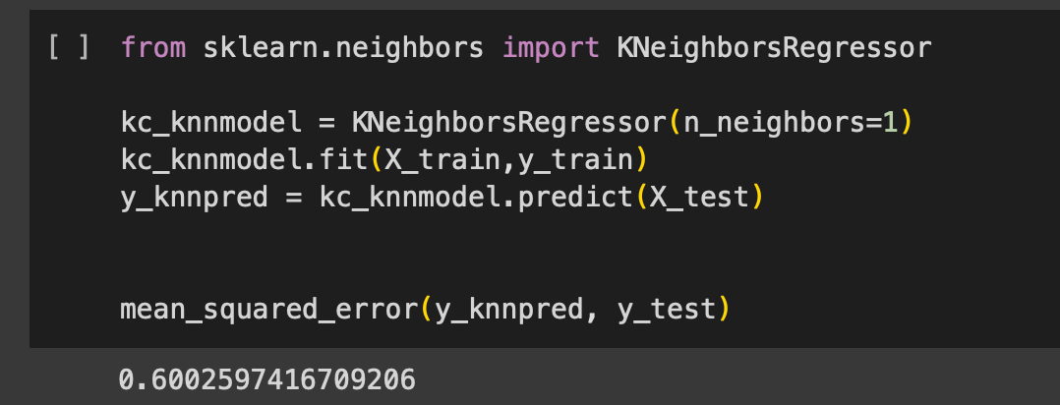
Create K Nearest Neighbour Model

Slide 47
What is a K-NN Model
The k-nearest neighbors (k-NN) algorithm is a non-parametric, instance-based learning algorithm used for both classification and regression tasks. It works by assigning the class or value of the most similar training example to a new data point. The "k" in k-NN refers to the number of nearest neighbors considered in the classification or regression process.
Key Characteristics of k-NN:
Non-parametric: k-NN does not make any assumptions about the underlying data distribution, making it adaptable to various data types and relationships.
Instance-based learning: k-NN classifies or predicts based on the similarity of the new data point to existing training examples, rather than relying on explicit parameter estimation.
Lazy learning: k-NN defers the actual classification or prediction until a new data point arrives, making it adaptable to dynamic environments.
Versatility: k-NN can be used for both classification and regression tasks, making it a versatile algorithm for various machine learning applications.

Slide 48
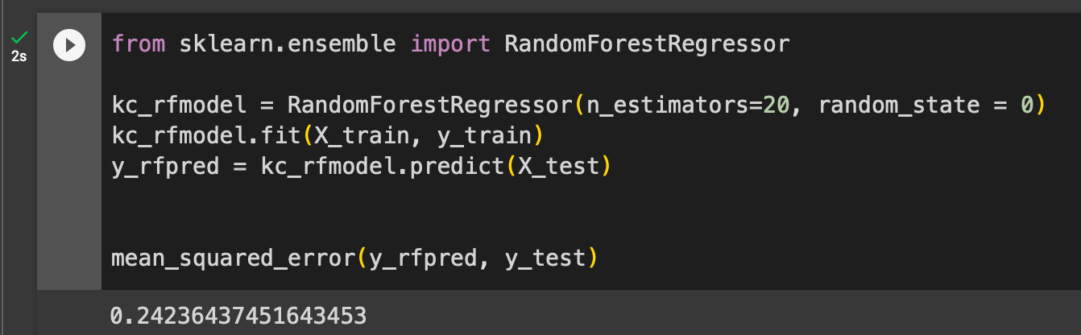
Create Random Forest Model

Slide 49
What is a Random Forest Model
A random forest is a versatile and powerful machine learning algorithm that combines multiple decision trees to create a more accurate and reliable model. It is a popular choice for both classification and regression tasks due to its ability to handle complex relationships, handle missing values, and reduce overfitting.
Key Characteristics of Random Forest:
Ensemble learning: Random forest combines multiple decision trees, reducing the variance and improving the overall predictive performance.
Bootstrap aggregation (bagging): Random forest trains each decision tree on a randomly sampled subset of the training data, introducing diversity and reducing overfitting.
Feature randomness: Random forest randomly selects a subset of features at each split of a decision tree, further reducing overfitting and improving generalization.
Non-parametric nature: Random forest does not make assumptions about the underlying data distribution, making it adaptable to various data types and relationships.
Robustness to outliers: Random forest is less sensitive to outliers compared to traditional decision trees, making it more robust to noisy data.

Slide 50
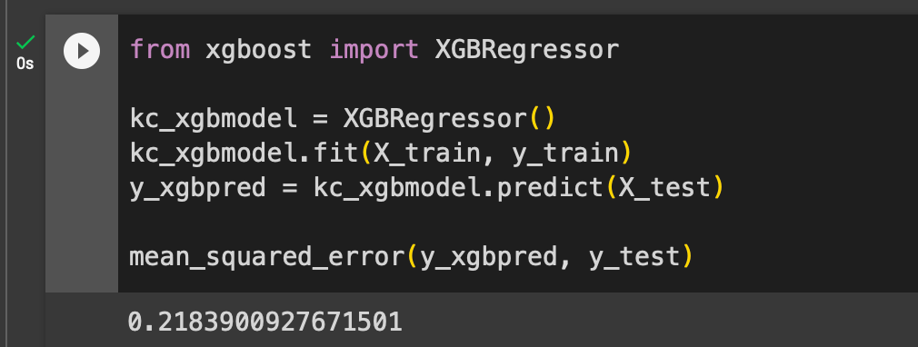
Create XGBoost Model

Slide 51
What is an XGBoost Model
XGBoost (eXtreme Gradient Boosting) is a powerful machine learning algorithm that has gained popularity in recent years due to its remarkable performance in both classification and regression tasks. It is a type of ensemble learning algorithm that combines multiple decision trees to improve the overall predictive accuracy and reduce overfitting.
Key Characteristics of XGBoost:
Gradient boosting: XGBoost utilizes gradient boosting, an iterative process of adding new decision trees that focus on the most challenging areas of the data, gradually improving the model's performance.
Regularization: XGBoost incorporates regularization techniques, such as shrinkage and L1/L2 regularization, to prevent overfitting and improve generalization ability.
Sparsity awareness: XGBoost is designed to handle sparse data efficiently, making it suitable for datasets with a large number of features and relatively few instances.
Scalability: XGBoost can be efficiently parallelized and distributed, making it scalable to large datasets and high-performance computing environments.
Performance optimization: XGBoost is designed for speed and efficiency, utilizing various techniques such as column sampling and cache optimization to reduce training time.

Slide 52
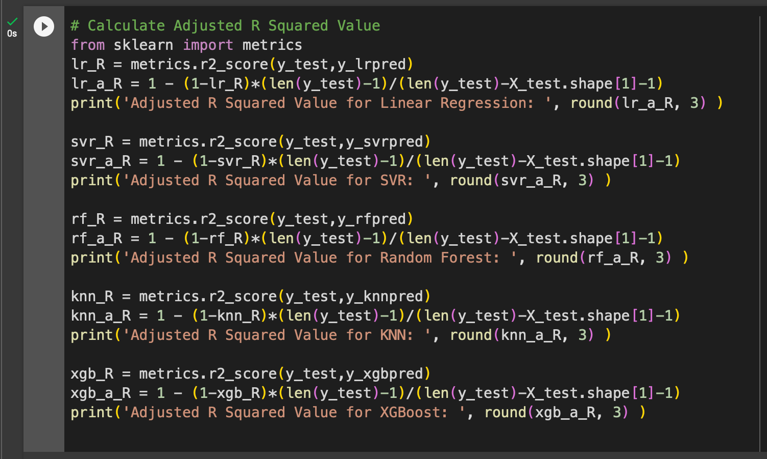
Measuring the Models

Slide 53
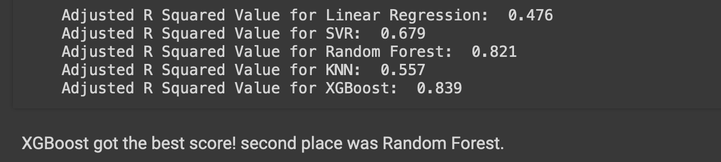
Measuring the Models

Slide 54
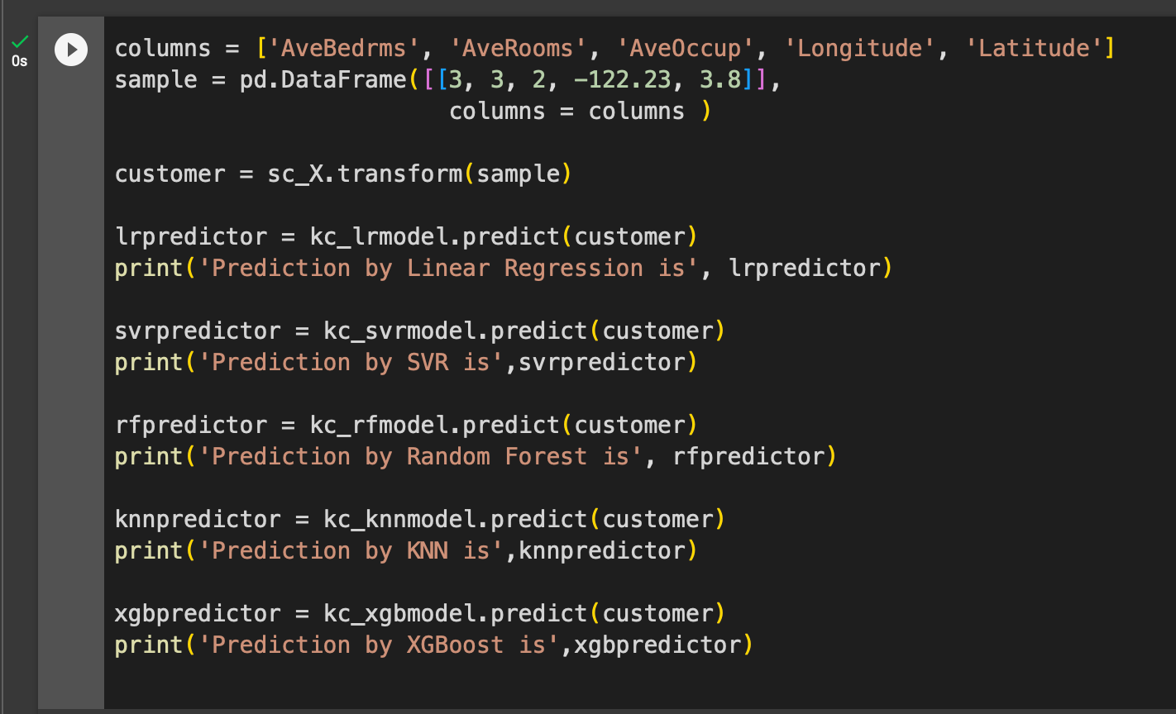
A real sample prediction

Slide 55
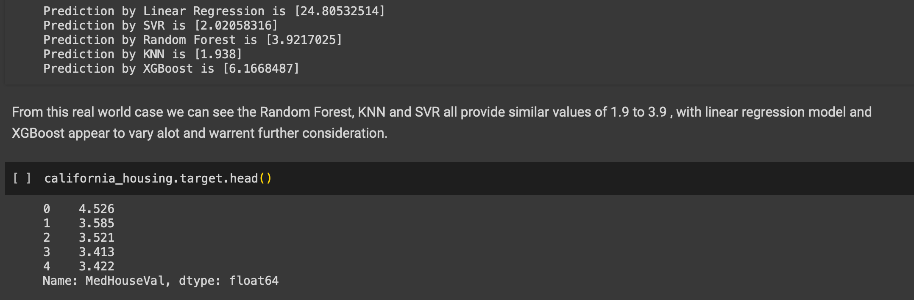
A real sample prediction

Slide 56
HOMEWORK
Study the provided code and complete the following task:
Identify why Linear Regression Model is failing to accurately predict for the provided sample
Determine why XGBoost Model also fails but by a smaller margin
Suggestions:
Check for outlier data values
Maybe try different features as input to the model fitting process.

Slide 57
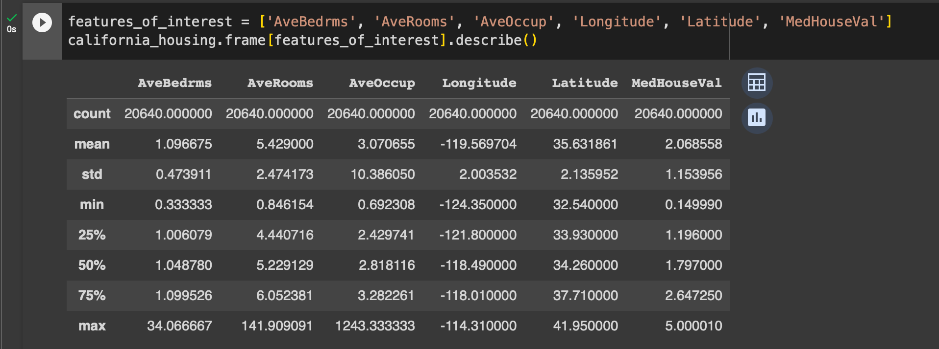
Compare predictions with actual data

Slide 58

demo of K-Means clustering
Classification or Regression Demo?

Slide 59
DEMO 1- Identify Handwritten Digits
Purpose of demo is to identify handwritten digits.
Using SciKit Learn as our framework
Using K-Means clustering on the handwritten digits data
Use Jupyter Notebooks for experimental interactive analysis.

Slide 60
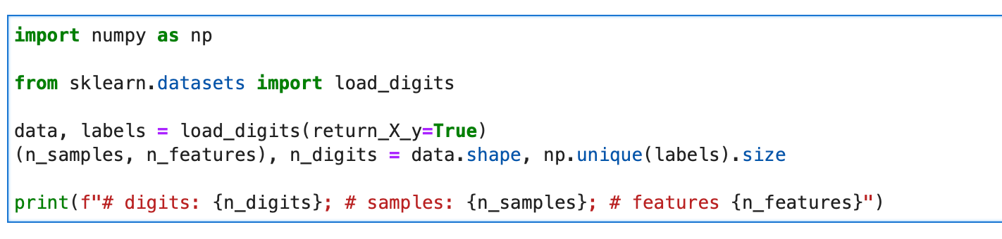
Load Data
First load the digits dataset.
Dataset contains handwritten digits from 0 to 9.
Clustering - group images such that the handwritten digits are the same.

Slide 61
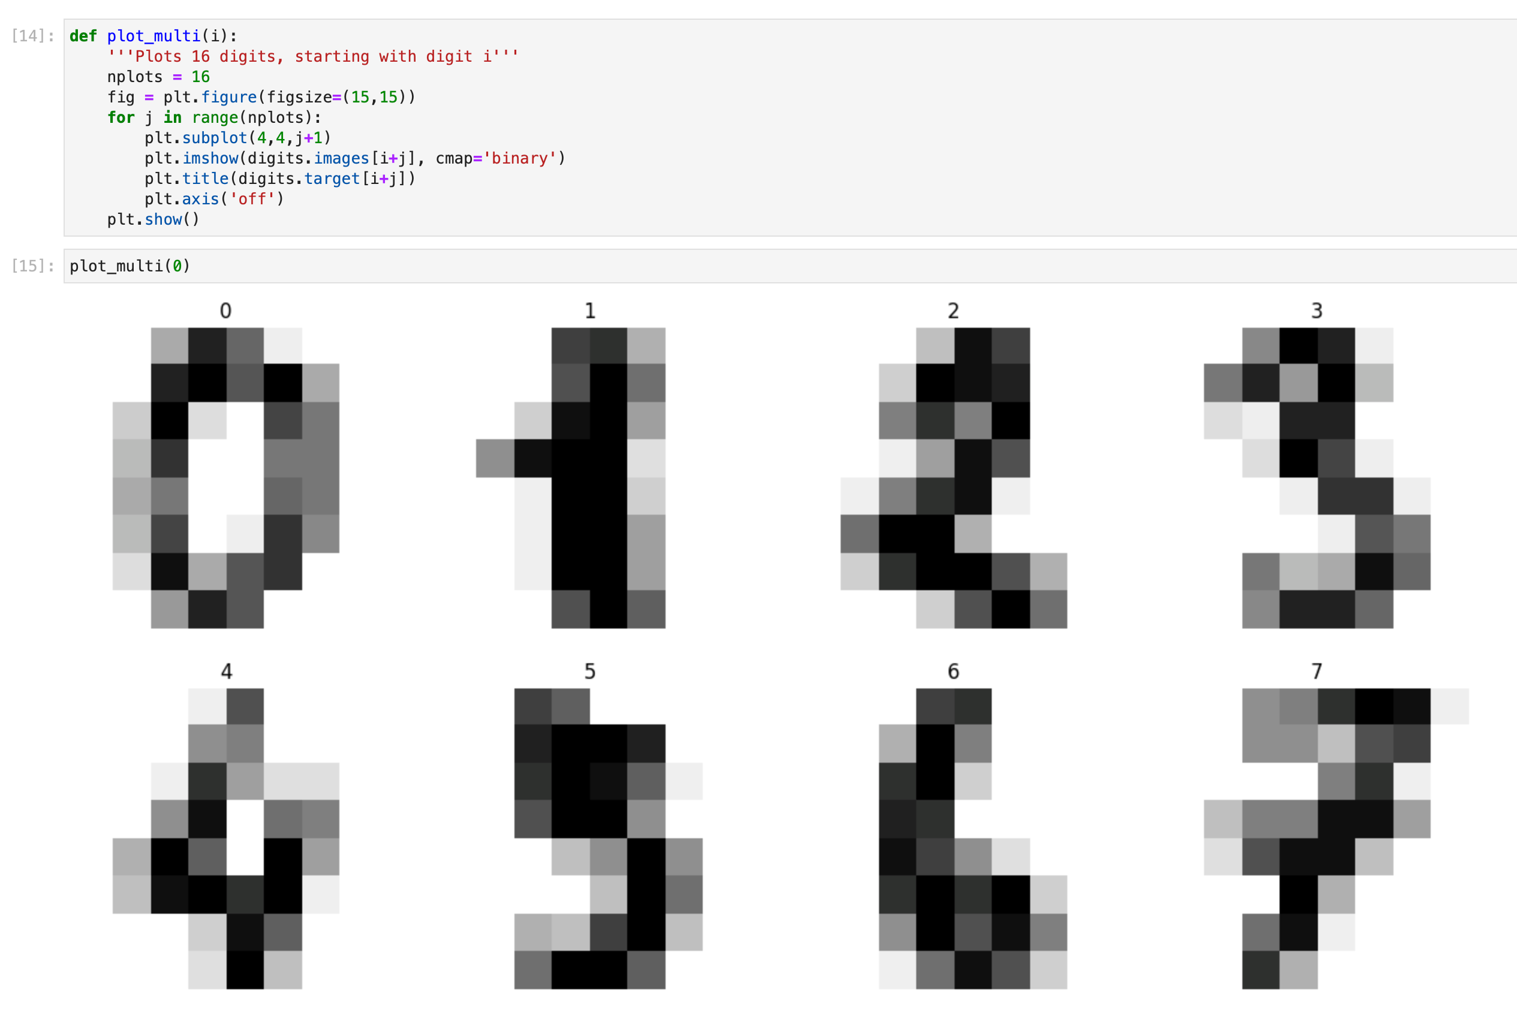
View the data

Slide 62
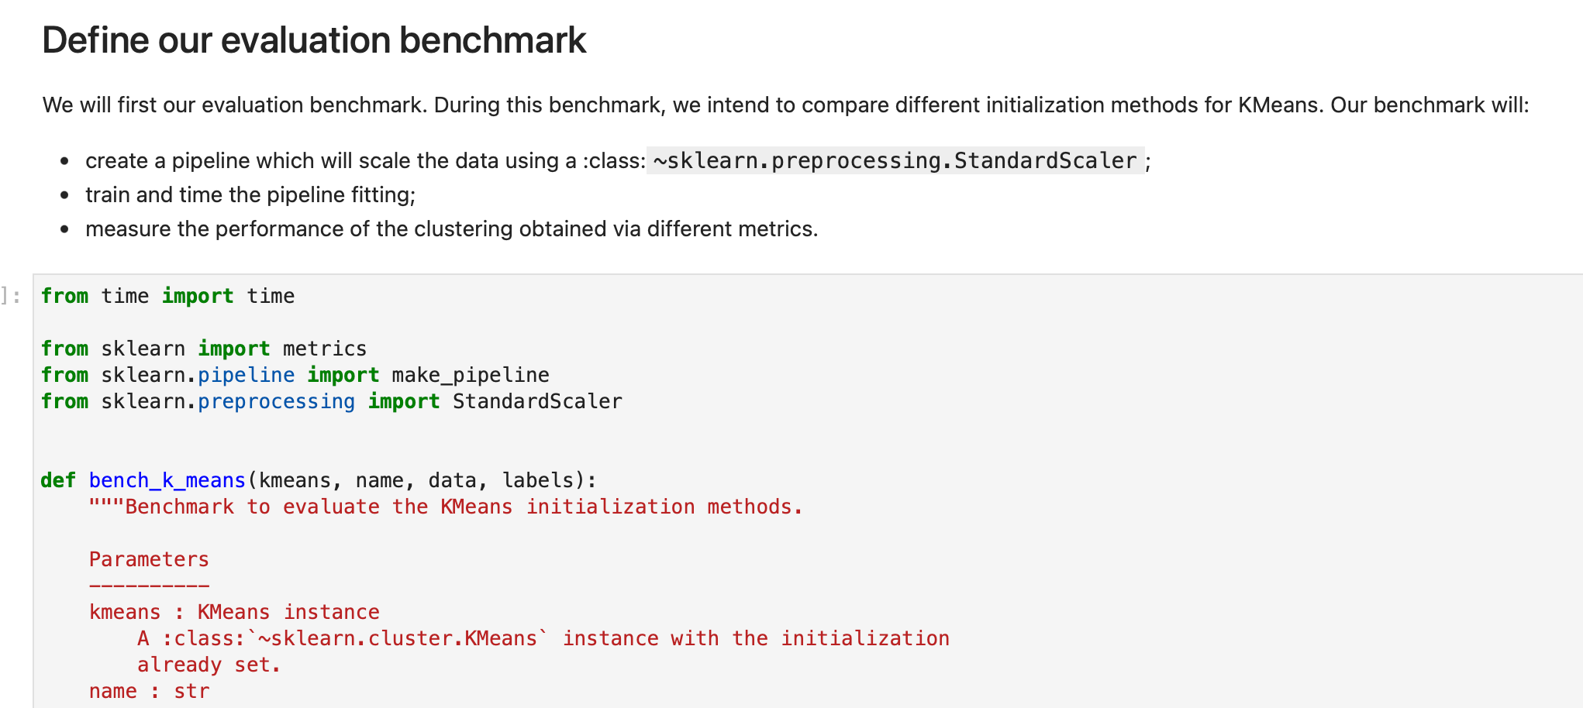
Define evaluation benchmark

Slide 63
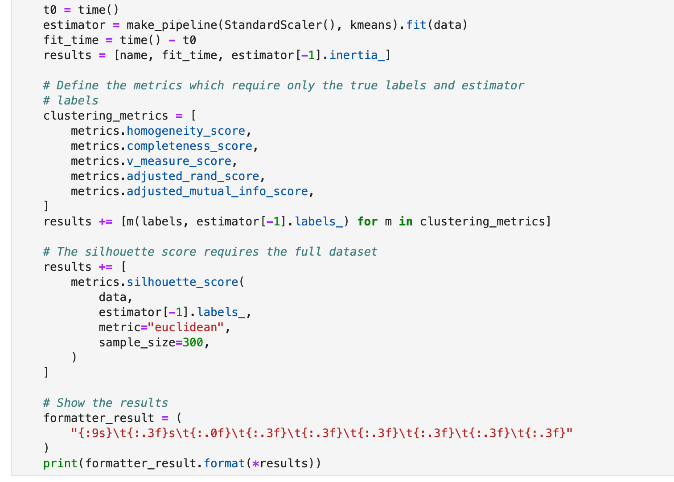
K_MEANS Function
Function code for evaluation benchmark

Slide 64
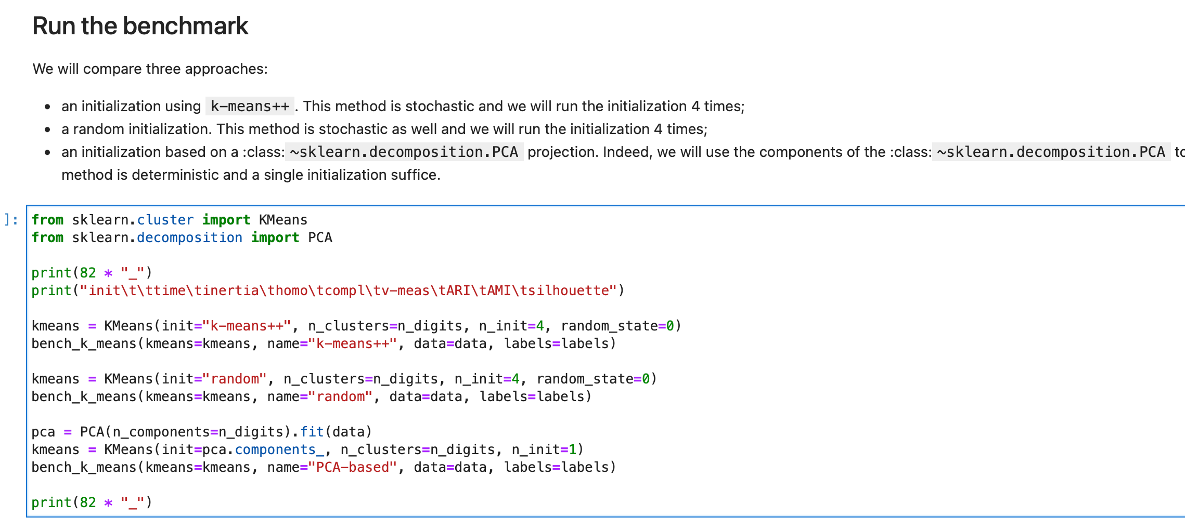
Run the benchmark

Slide 65

Visualize Results

Slide 66

Visualize Results

Slide 67

K Means clustering on digits dataset
project the data from the original 64-dimensional space into a lower dimensional space
project into a 2-dimensional space and plot the data and clusters

Slide 68
REFERENCES
https://github.com/bhrionn/CORVINUS-AI/blob/main/CaliforniaHousingDataNotebook.ipynb
https://inria.github.io/scikit-learn-mooc/python_scripts/datasets_california_housing.html
https://www.kaggle.com/code/qingyueyang/predict-house-price-regression-model
https://hub.ovh2.mybinder.org/user/scikit-learn-scikit-learn-ixobm1ex/lab/tree/notebooks/auto_examples/cluster/plot_kmeans_digits.ipynb

